Slide 1
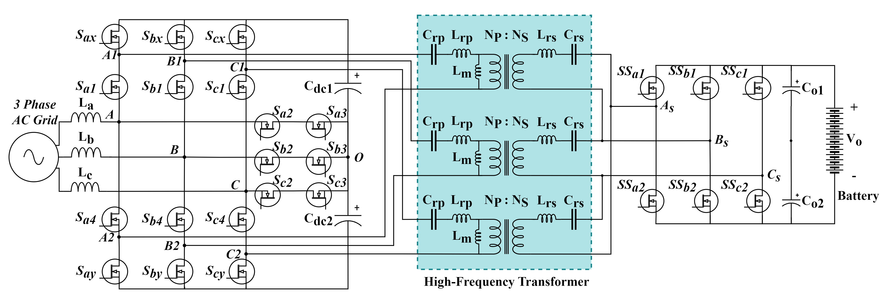
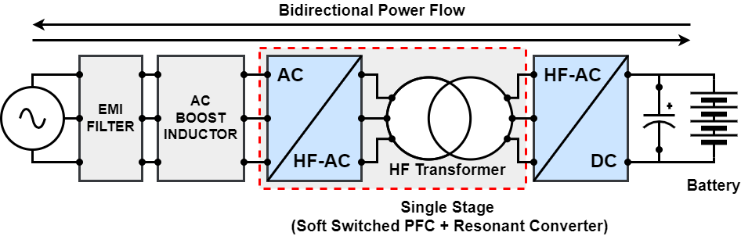
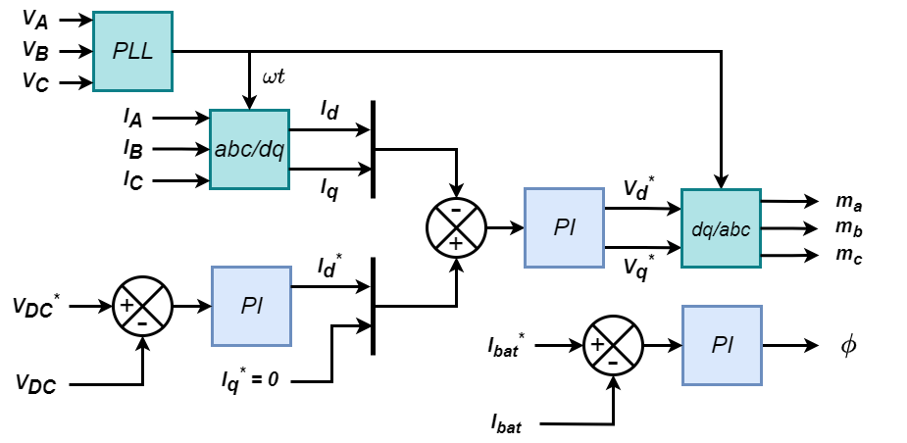
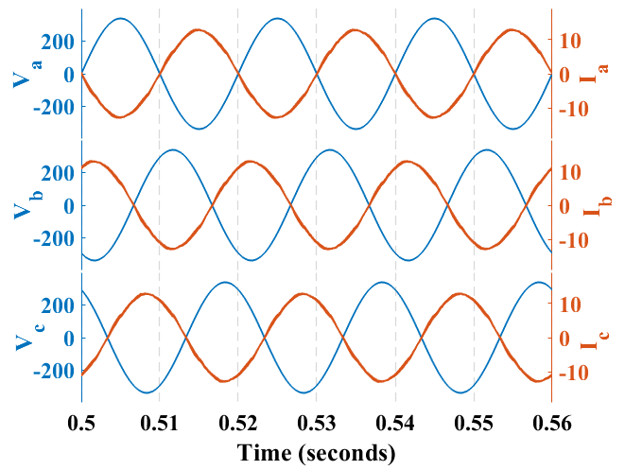
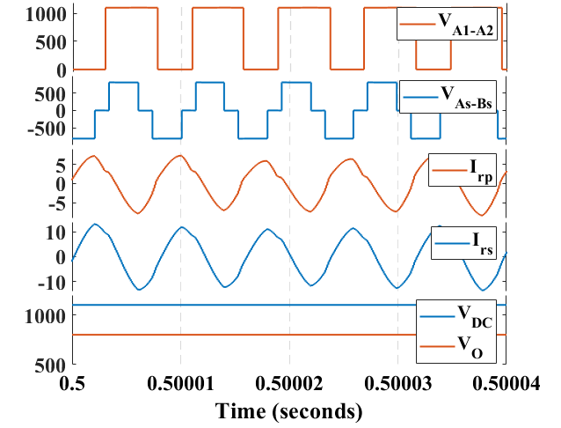
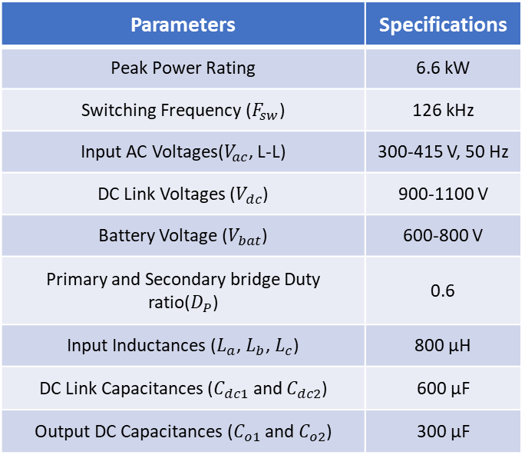
A Modified T-type Based Single-Stage 3-Level Isolated Bidirectional Off-Board Charger For Electric Vehicles
Parameters | Specifications
Peak Power Rating | 6.6 kW
Switching Frequency ($F_{sw}$) | 126 kHz
Input AC Voltages($V_{ac}$, L-L) | 300-415 V, 50 Hz
DC Link Voltages ($V_{dc}$) | 900-1100 V
Battery Voltage ($V_{bat}$) | 600-800 V
Primary and Secondary bridge Duty ratio($D_{P}$) | 0.6
Input Inductances ($L_{a}$, $L_{b}$, $L_{c}$) | 800 µH
DC Link Capacitances ($C_{dc1}$ and $C_{dc2}$) | 600 µF
Output DC Capacitances ($C_{o1}$ and $C_{o2}$) | 300 µF
Features
  Dimension: L70cmXW37.5cmXH8.5cm
  Compact Design high power density
  Pre-charging and EMI filter circuit
  Integrated Sensor circuit.
  Decoupled Control of Two stages.
  Integrated Auxiliary power supply (230V)
  Controller: TMDSCNCD28379D
  Resonant Converter designed in ANSYS.
  Feedbacks: Current Sensing, DC Link Voltage Sensing, AC Voltage Sensing.
  Protections: Overload, Overvoltage.
Conclusion
Converter size is optimized due to the reduced number of power devices.
Transformer and Inductor size is reduced.
Disturbance rejection is improved.
Future Scope
The same scenario can be implemented with the other DC-DC and AC-DC configurations.
Advance control techniques can be implemented to optimize the performance.
Integration with renewable energy sources.

